Slide 1
Movie Recommendation System
Made By : Mrudani Songade
Enrollment no : 21002170510032
Roll Number : 209
Batch : a6
Branch : Aids

Slide 2
INTRODUCTION
Recommender System is a system that seeks to predict or filter preferences according to the user’s choices.
A movie recommendation system is a fancy way to describe a process that tries to predict your preferred items based on your or people similar to you.

Slide 3
Technology & Features used
Features
Listing movies per user
Recommending on genre and language of user
Technology
Django

Slide 4
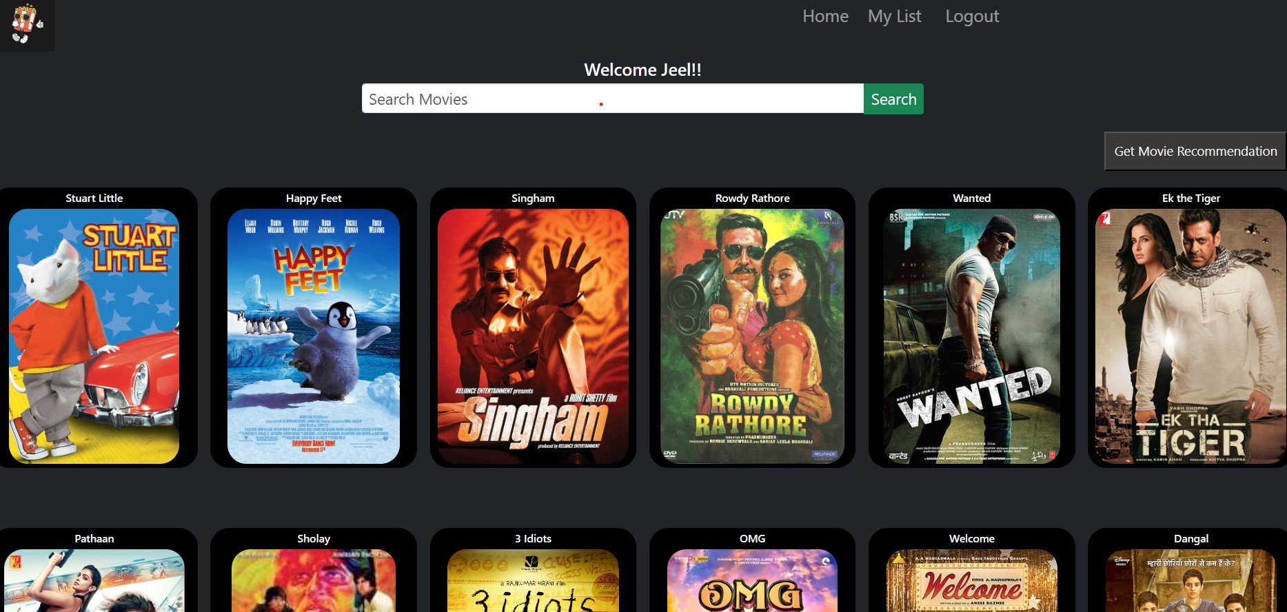
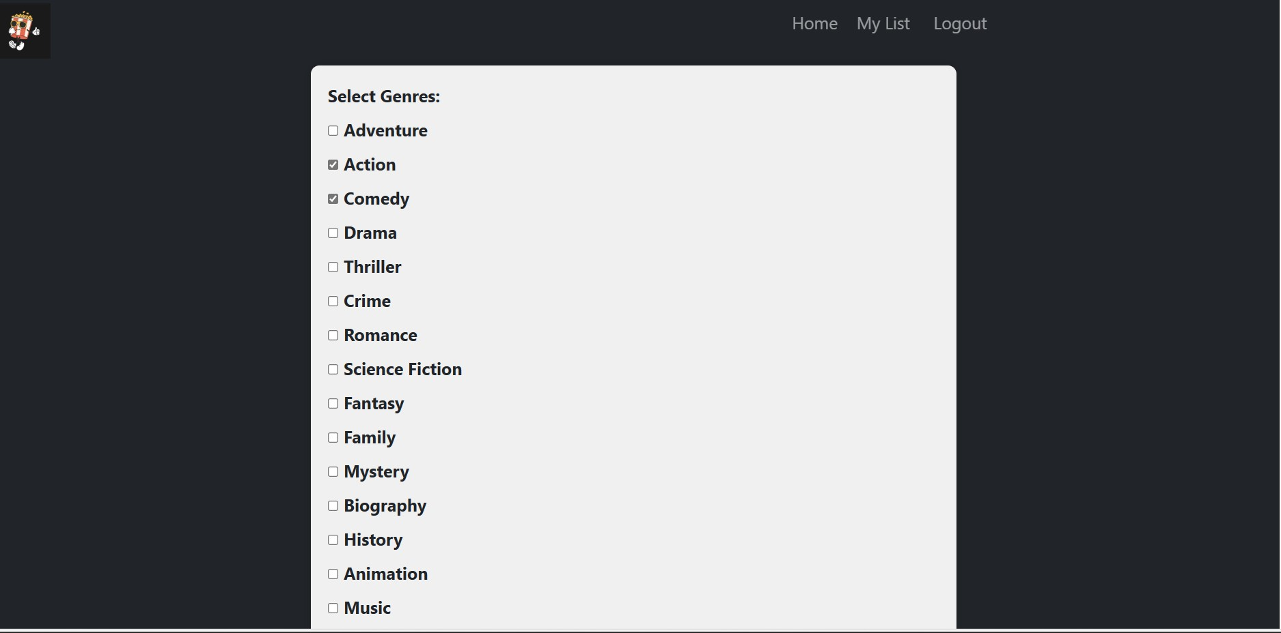
Output
Home page Filter page

Slide 5
Thank you!

